Slide 1
Programming for Data Science
with Python Nanodegree - Udacity
Postgre SQL Project:
Investigate a relational database (sakila movie database)

Slide 2
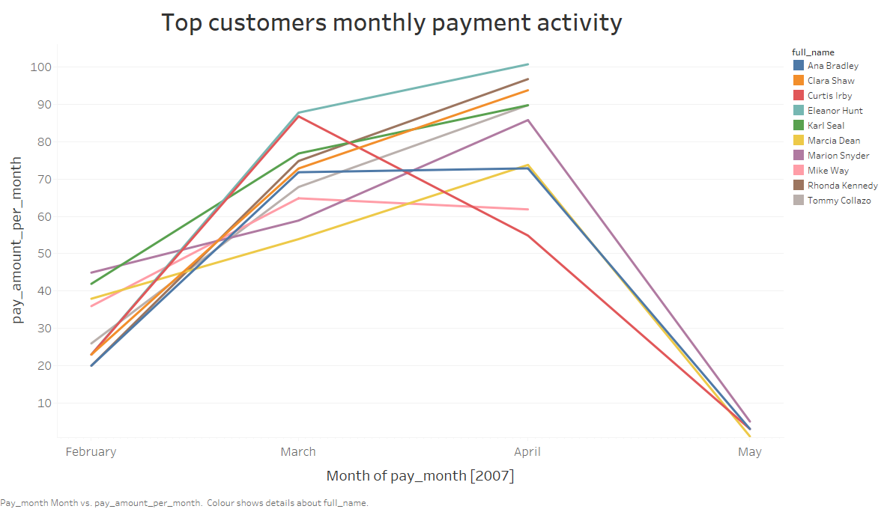
Q1: When does top customers paid most amount?
<visualization>
The highest payments from top customers are received in April, 2007 followed by March, 2007. However there is a significant drop in the payments after March, 2007. This might be the result of either excess payments from customers or lack of resources that meet the customers taste.

Slide 3
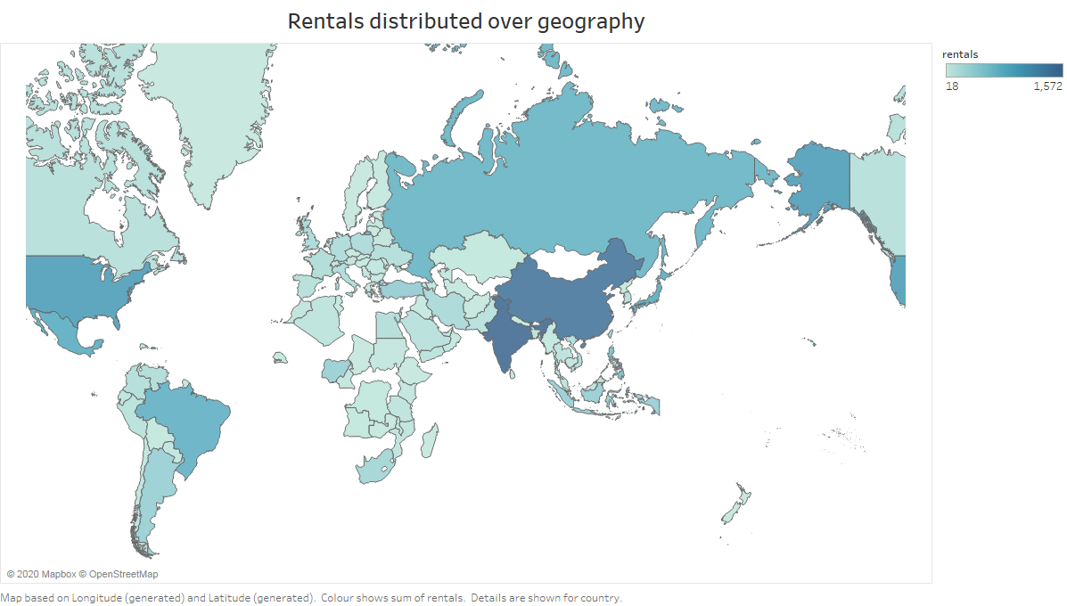
Q2: Where should the customer accquisition funds should be spent to increase the rentals?
<visualization>
The graph depicts the geographical spred out of the rentals over various countries. It can be observed that both India and China are the leading counties in terms of number of rentals, followed by Russia, United States and Brazil. Hence the customer accquisition costs must be cut in there regions and should be directed to other regions with low rentals and high population like Africa Canada and Europe.

Slide 4
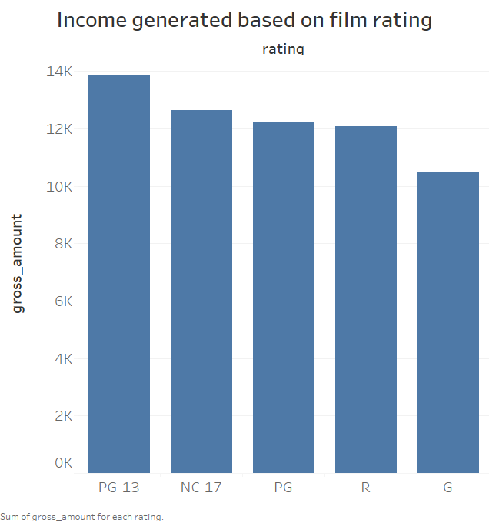
Q3: Which films generate most income based on ratings?
<visualization>
The films with PG-13 generated most income compared to films with different rating. However, it can be determined that the difference in income generated by films, based on the ratings are slim and can be overlooked. Since the ratings are not the most influencing factors in the income generation, other factors must have been playing a prominent role.

Slide 5
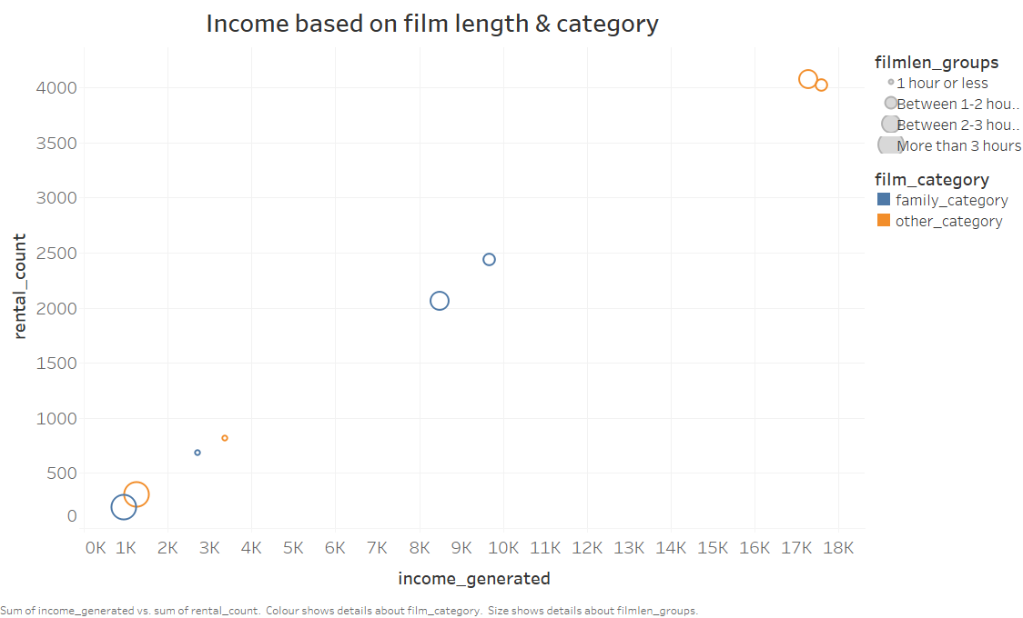
Q4: What are the most influencing factors in income generation?
<visualization>
The graph depicts that the films with duration ‘Between 1-2 hours’ and ‘Between 2-3 hours’ are more likely to get rented by the customers. In turn, categories apart from ‘family category’, generate more income compared to ‘family categories’.
This concludes that the film category and its duration plays a prominent role in income generation.

Slide 6
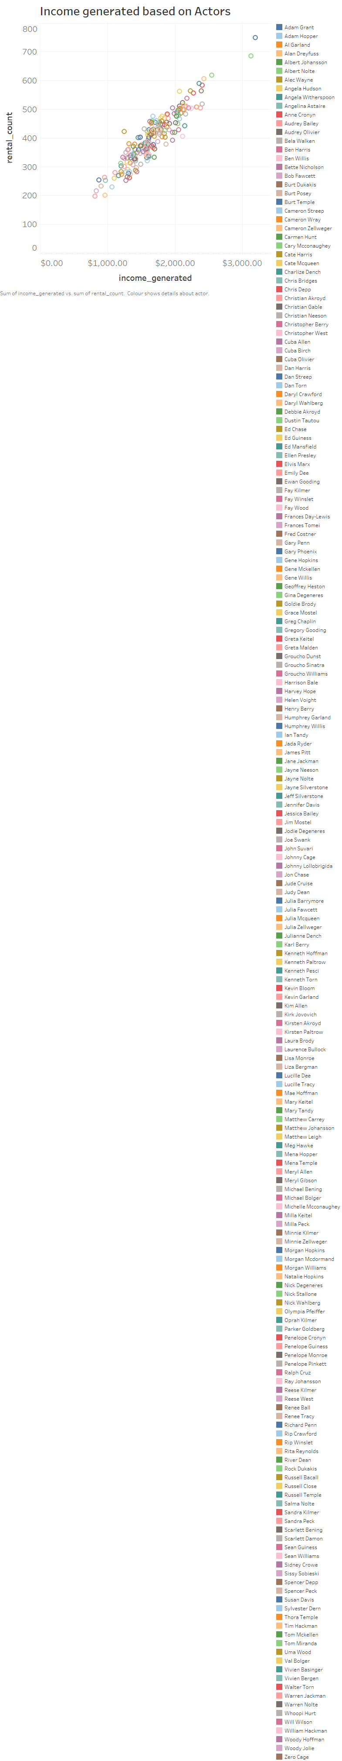
Q5: What influences the income generated by any actor?
<visualization>
The graph reflects that the relation between, the number of times a dvd has been rented and income generated from it is a clear linear equation with a positive slope. This evaluates to the conclusion that the income generated by each actor is directly proportional to his popularity in having his films rented more frequent. This can be observed in the graph that some actors generate more income compared to less popular actors.

Slide 7
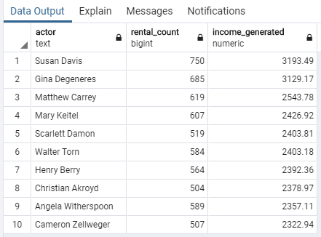
Q6: Who are the actors that generate most income ?
<visualization>
The resulting table is the list of top 10 actors that generate most income compared to other actors. Among them Susan Degeneres is the most popular actor generating a highest income of 3193.49 dollars. It can also be observed that some actors generate more income even when their films are rented comparatively less frequent. Scarlett Damon and Christian Akroyd are a good example for this occurrence.

Slide 8
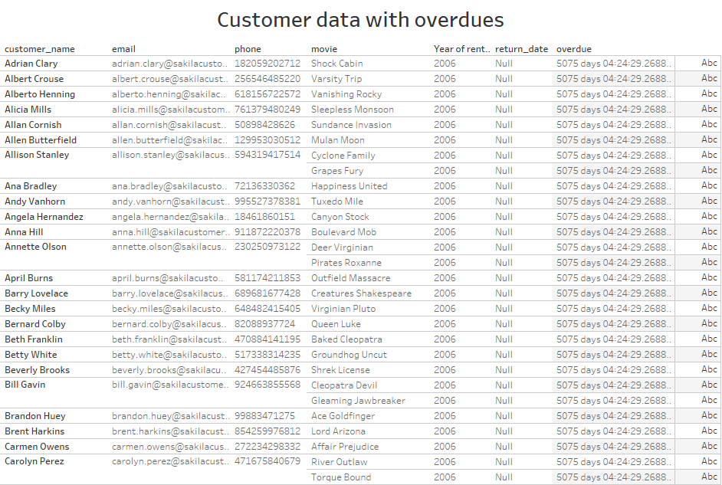
Q7: Are there any overdues from the existing customers?
<visualization>
A total of 180 overdues were detected from the existing customers. The graph diaplays the list of customers with overdues along with their contact information and data related to their rentals as in the film rented, rental date and overdue count in days. The contact information of the customers is highly useful in the retrival of the rented dvd’s.

Slide 9
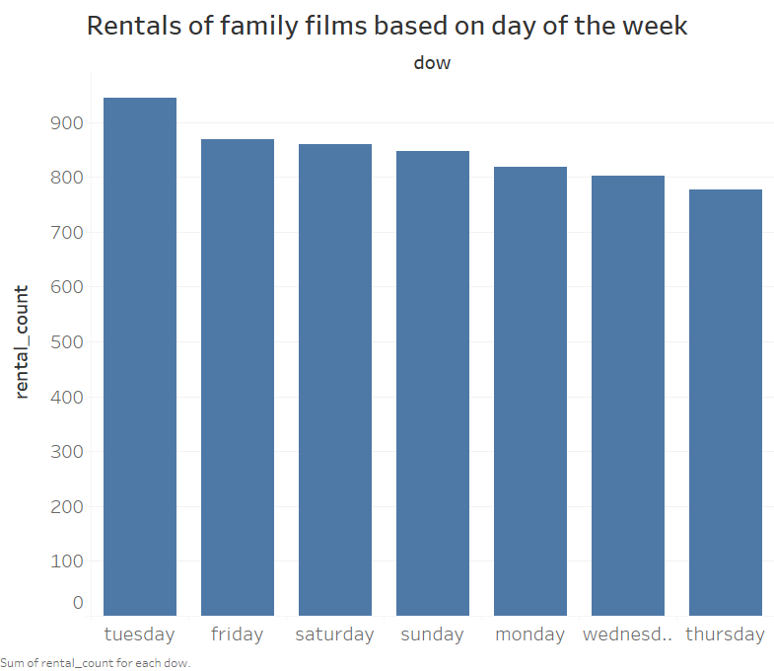
Q8: When does the family films rented most based on the day of the week?
<visualization>
(Family films include below categories : Animation, Children, Classics, Comedy, Family and Music)
From the graph, it can be observed that the rentals of family films increase at the beginning of weekend and decline as the days go by. It can also be observed that the most rentals occur on the Tuesday despite not being the weekend.

